Slide 1
RGIPT Student helpdesk cum automated chatbot (Divyanshi Singh 20cs3028)

Slide 2
The Problem
What is the problem?
Reporting and resolving complains, or any query by the students at the institute systematically.
Target audience students?
Students at RGIPT
Why should this problem be solved?
How will I know this problem has been solved?
Database System and Updates on profile, feedback and suggestions from students.
It would help the

Slide 3
UPLOAD PROJECT LINKS
VIEW PROFILE
UPDATE PROFILE
(PARTIALLY)
GENERATE RESUME
STUDENT
CHANGE PASSWORD
CODE EMBEDDED FOR SOME PYTHON PROJECTS
REPORT/VIEW COMPLAIN /QUERY
VERIFY QUERY STATUS
HELPDESK PORTAL
COMMON ISSUE
DATABASE ADMINISTRATOR
AUTOMATED CHATBOT
UNIQUE ISSUE
UPDATE QUERY STATUS
SERVICE PROVIDER

Slide 4
Benefits
Students can get basis information at single click.
Faster and efficient way to help students and resolving their issues with recorded data, especially for 1st and 2nd year students. They aren’t aware of many resources and can get confused when reach multiple people.
Many times student fear to complain about some serious issue due lack of confidentiality. Helpdesk would me secure and confidential way for them to openly put up their problems or fears without involving any outsider.
Can be more user friendly using automation.
This will save time and money.
Further, the long dataset can be used for some interesting statistical analysis of students’ performance.
Also, if worked on achieving a high SEO score can help the institute to improve page rank on web.

Slide 5
Chatbot Primary purpose
Answering FAQs?
Providing suggestions/advice information?
Playing some small quiz or riddle games relating to aptitude test?
Using the pre-resolved queries and entered dataset to help the students in an interactive manner.

Slide 6
Technologies used
HTML
CSS
JavaScript
Flask
SQLite
Dialogflow
DB Browser

Slide 7
Opportunities in cloud
Dialogflow enables users to develop human-computer interaction technologies that can support NLP. Basically, it lets you make Digital Programs that interact with end users through natural languages.
Users
Text/Voice
Intents and Expressions
Responses
Entities
Actions & Parameters
Cloud Database Hosting – storage efficient, easier access, higher security

Slide 8
Elements
Student Portal
Admin Portal
Service Provider Portal (mess, water, etc.)

Slide 9
STUDENT PORTAL
Student Registration
Student Login
Student Profile
Student Edit Profile
Student Change Password
Student Help Desk
Student Queries – View Query, Add Query
RGIPT Chatbot (Dialogflow) – Chat with bot, get answers to FAQs
Student Handbook
Student Forms

Slide 10
ADMIN PORTAL
Admin Registration
Admin Login
Admin Desk
View all queries
Verify the status of queries and update database

Slide 11
Service PROVIDER PORTAL
Service Provider Registration
Service Provider Login
Service Provider Desk
View only the queries related to a particular service type
Update the status of queries

Slide 12
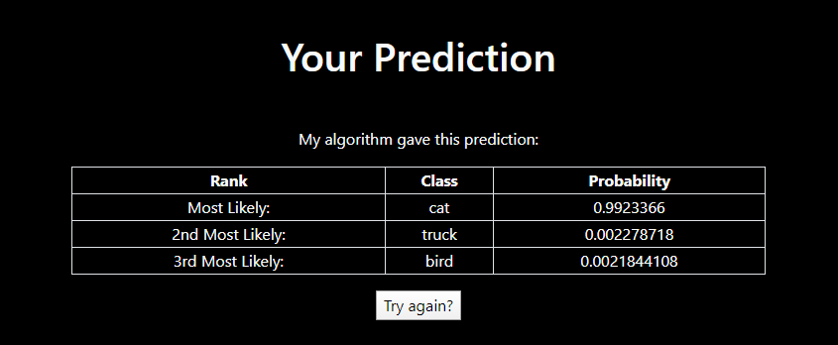
Future advancements to Deploy Machine Learning Models
Building a Web Application to Deploy Machine Learning Models | by Joseph Lee Wei En | Towards Data Science

Slide 13
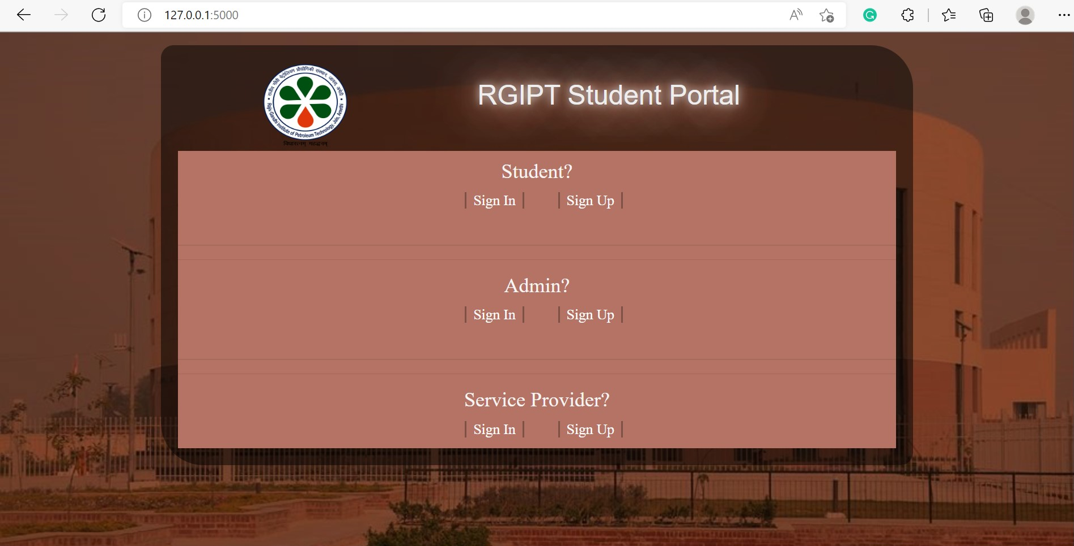

Slide 14
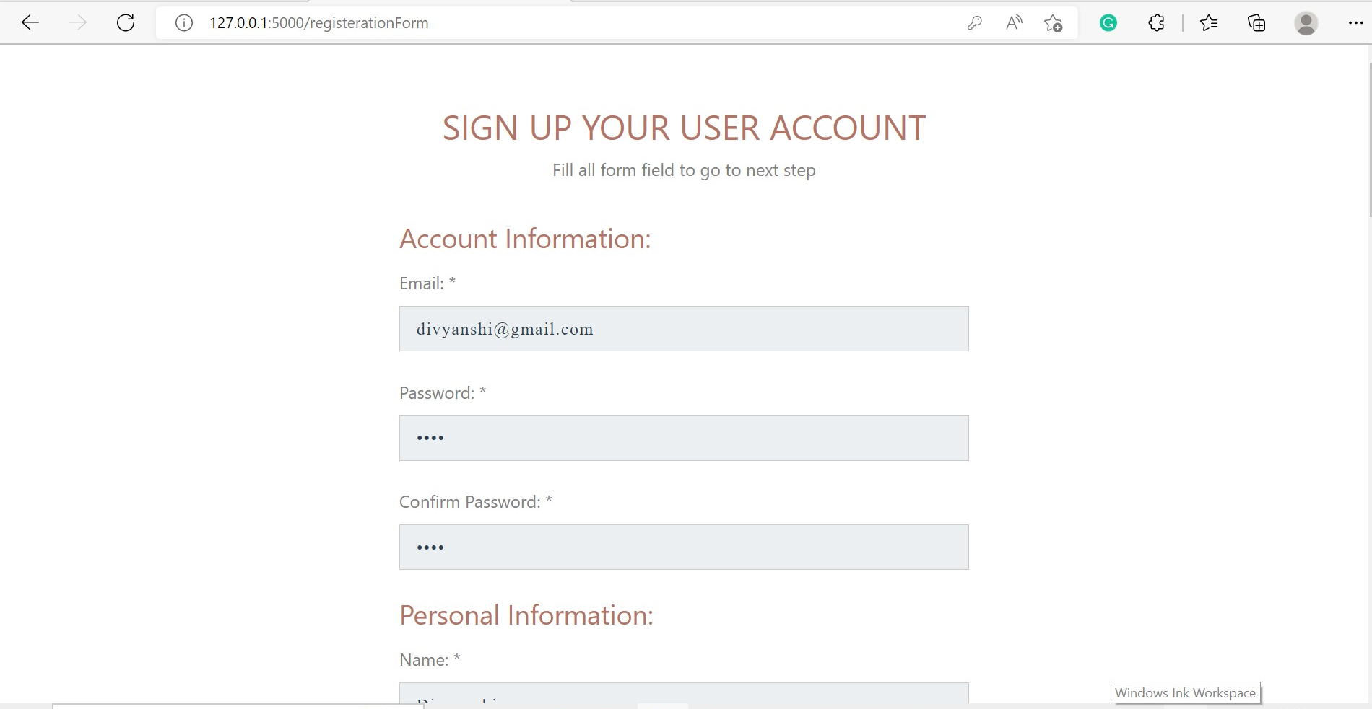

Slide 15
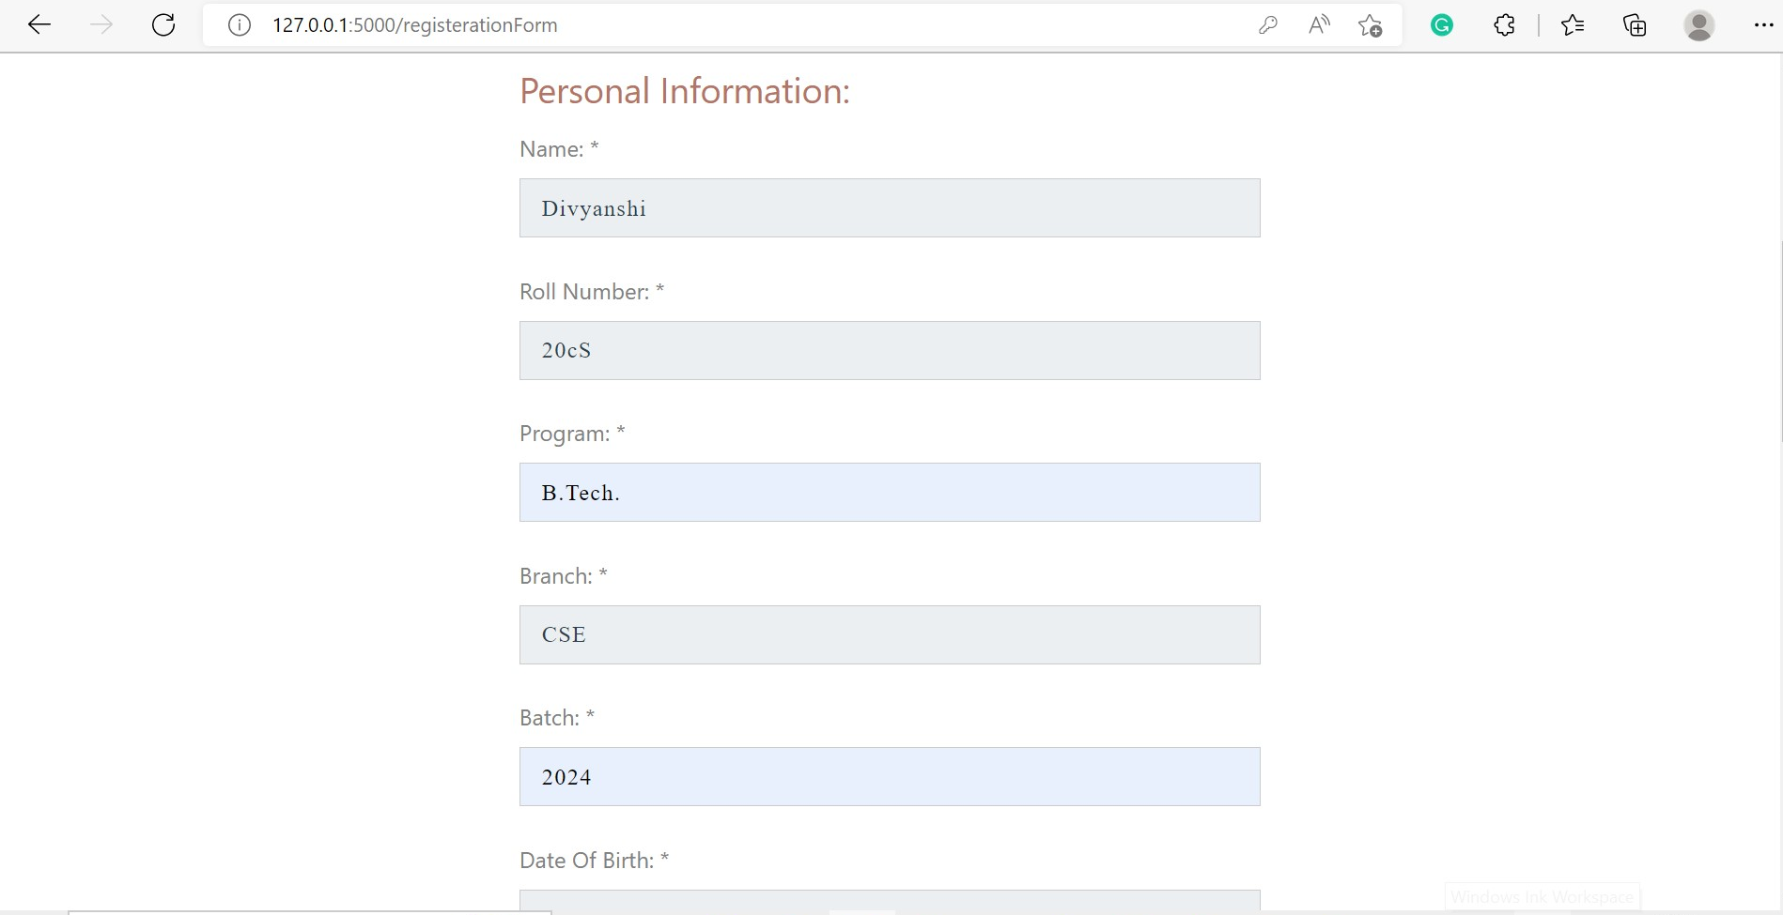

Slide 16
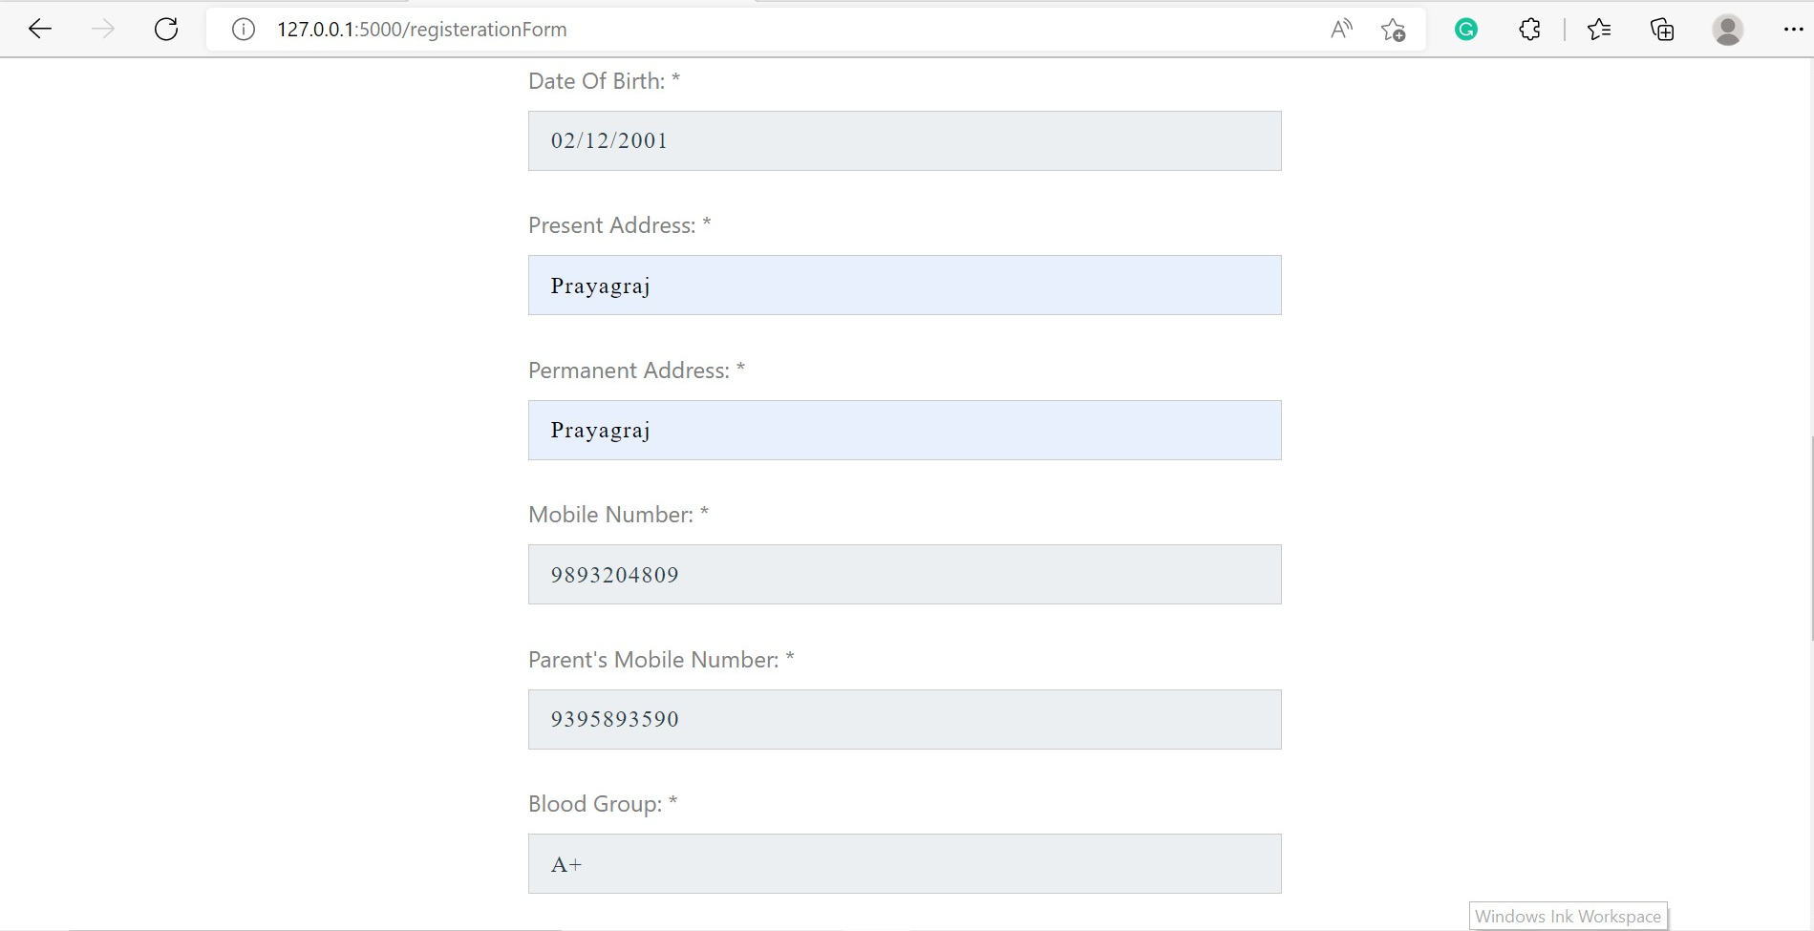

Slide 17
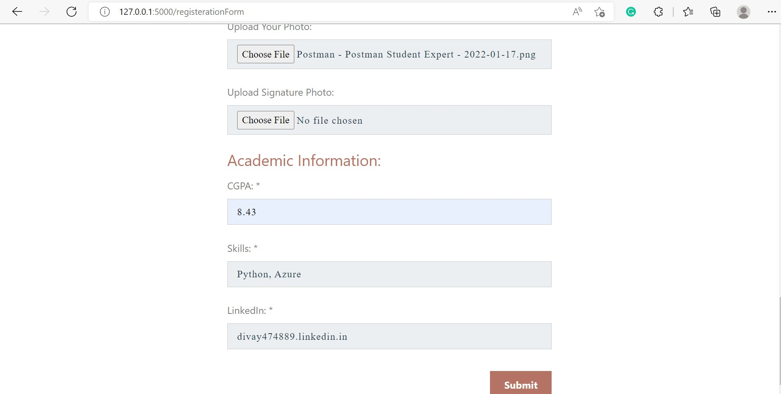

Slide 18
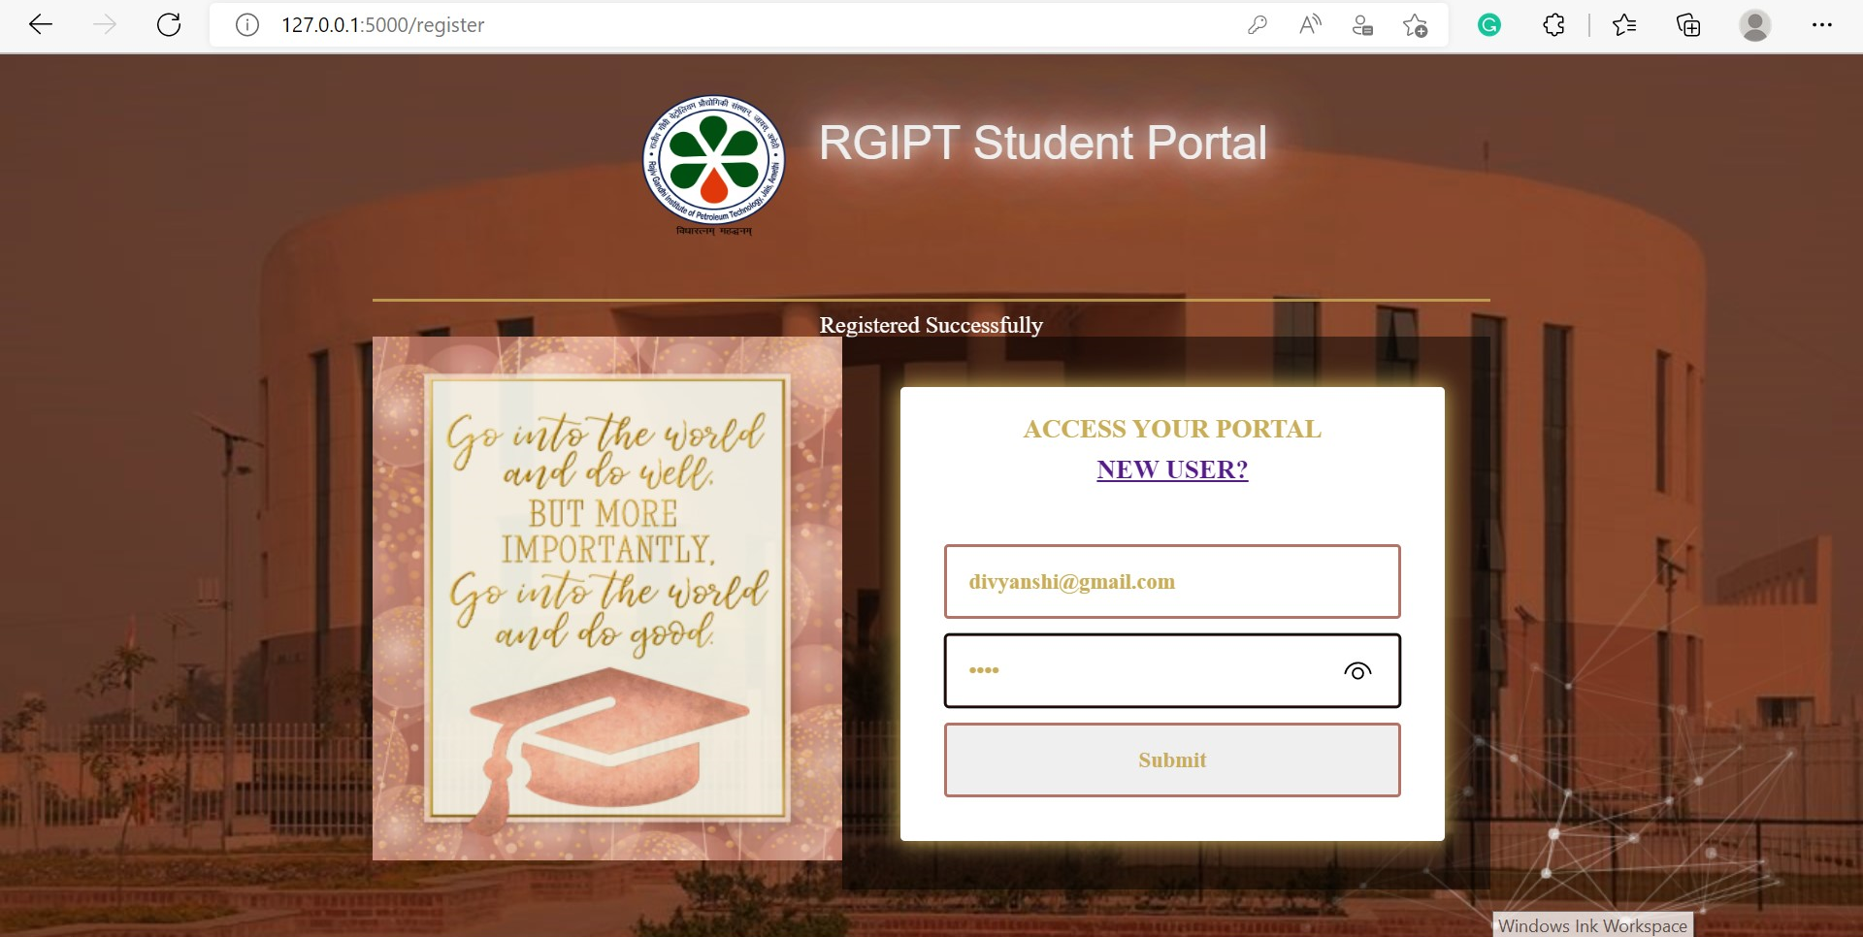

Slide 19
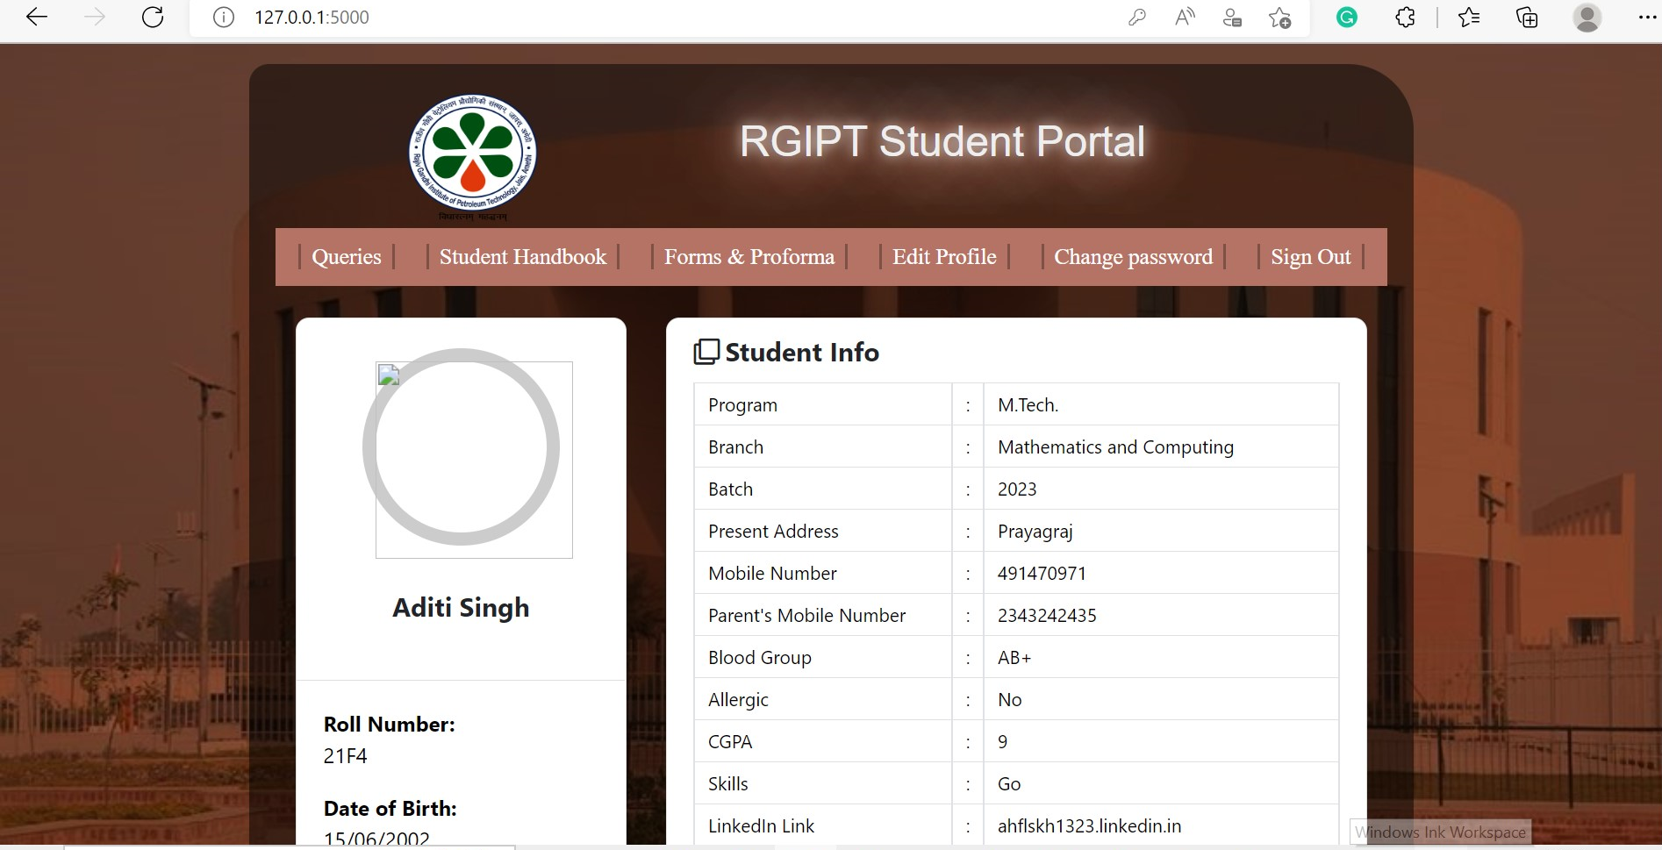

Slide 20
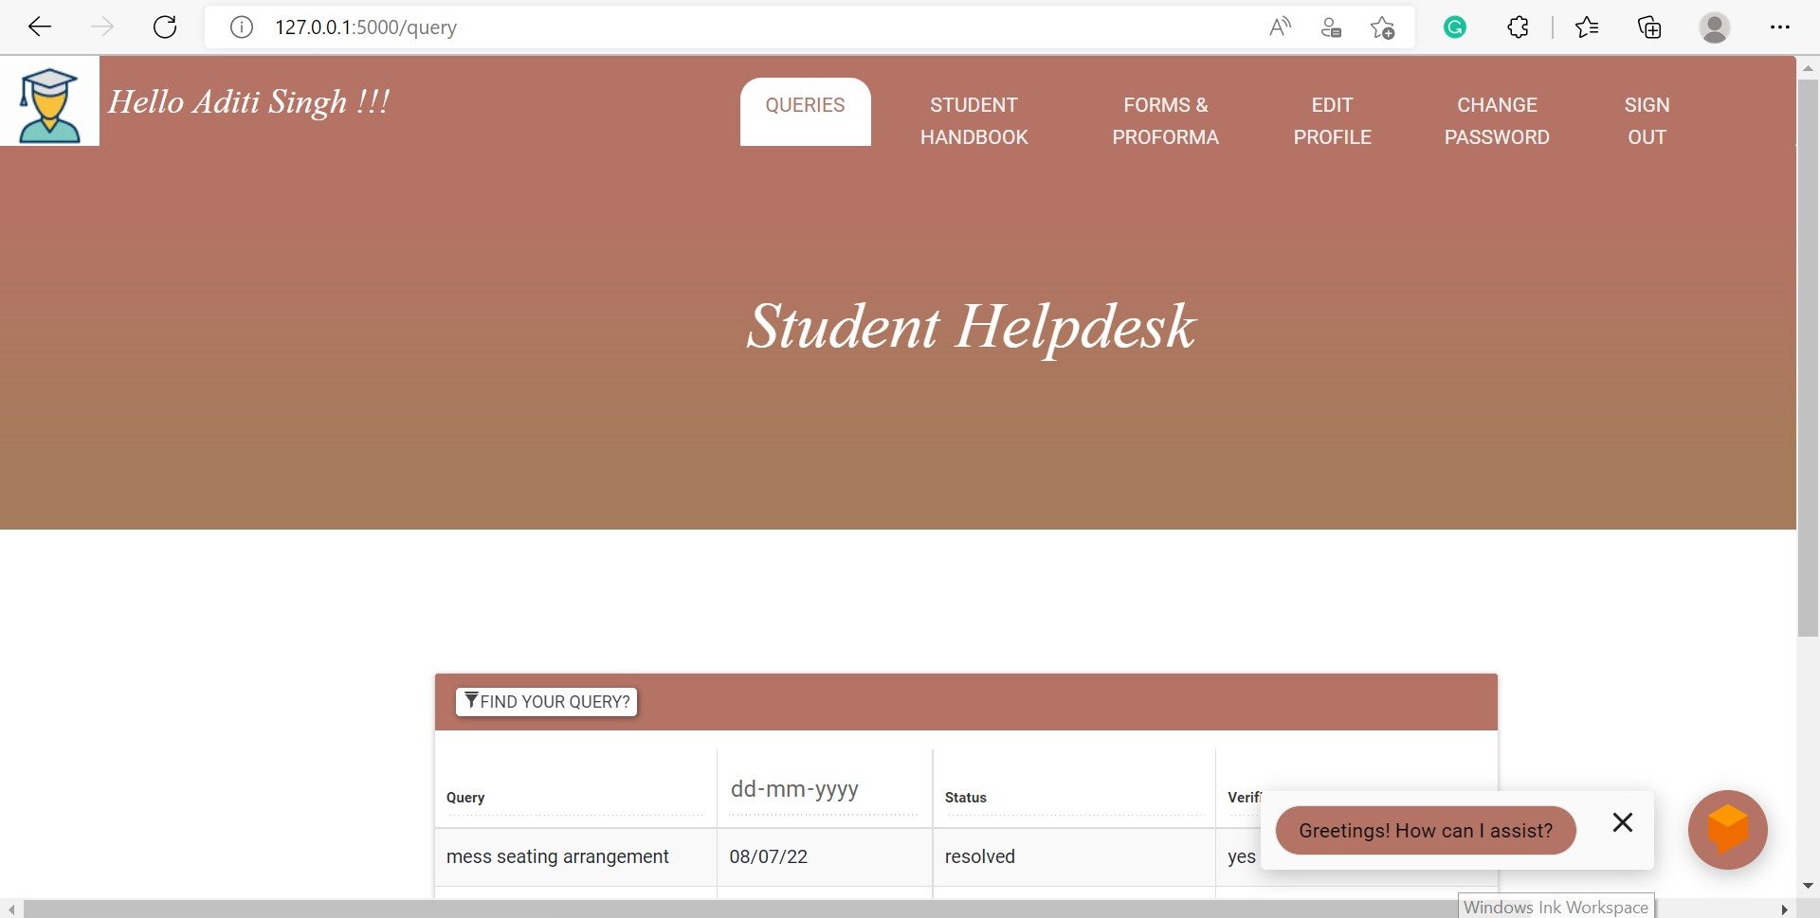

Slide 21
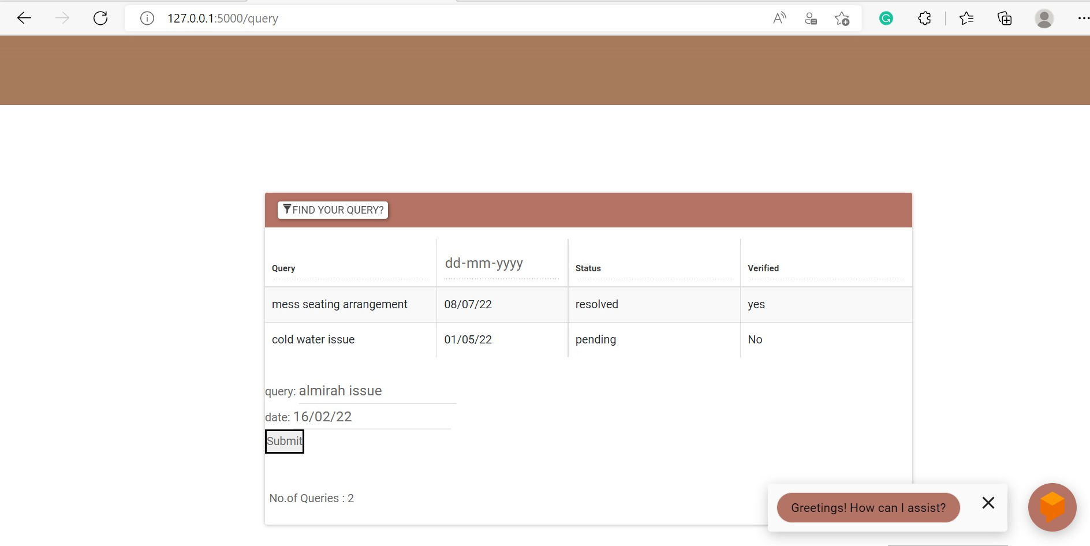

Slide 22
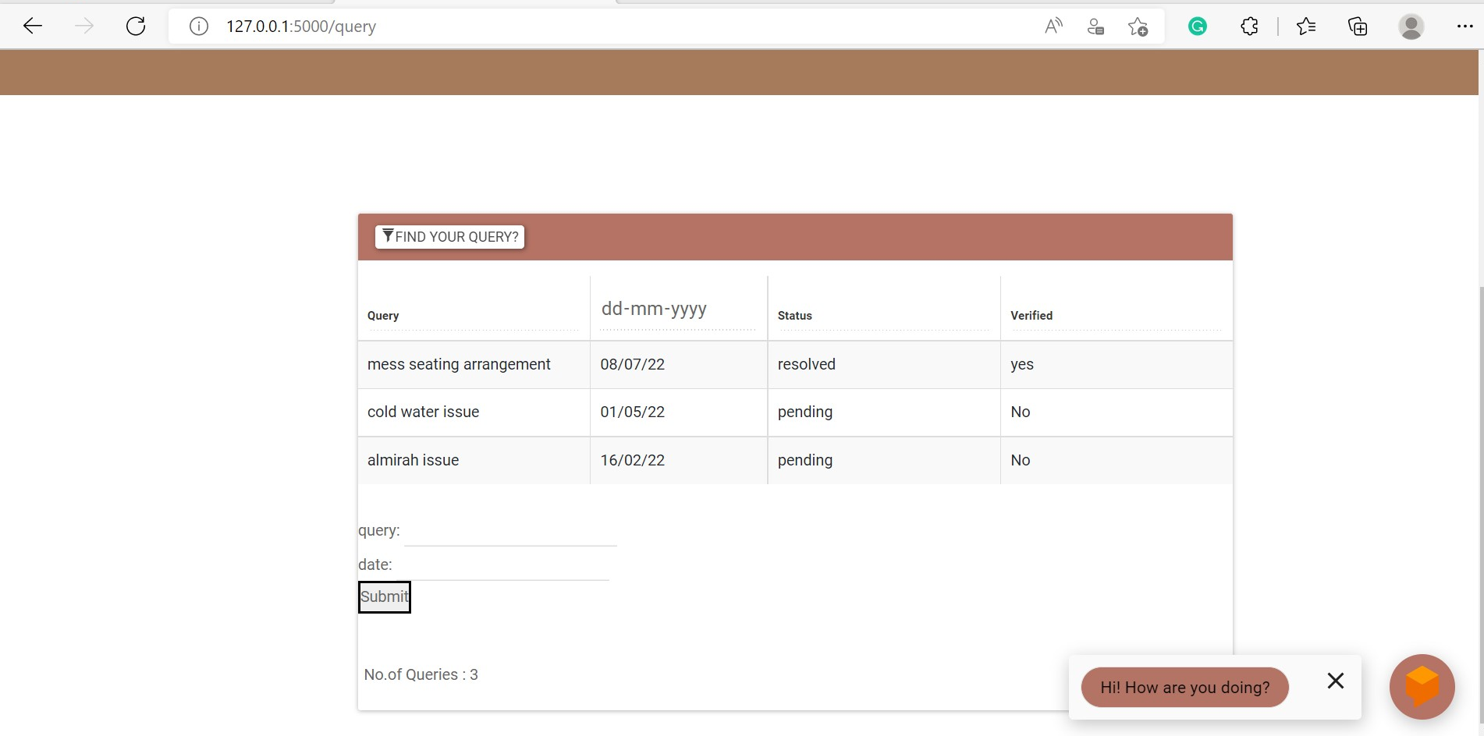

Slide 23
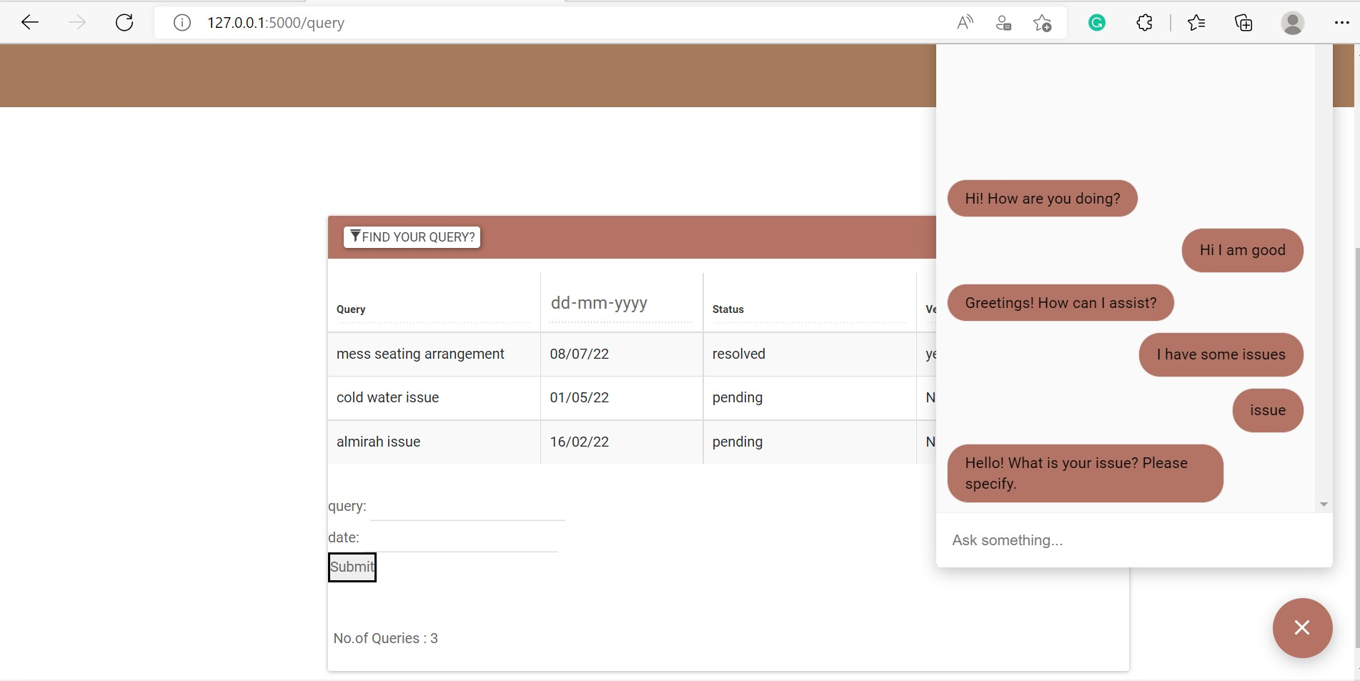

Slide 24
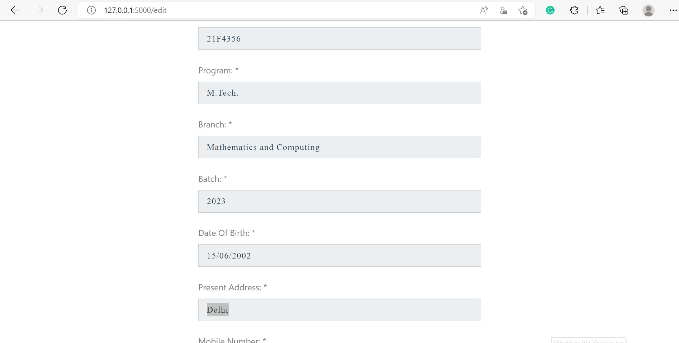

Slide 25
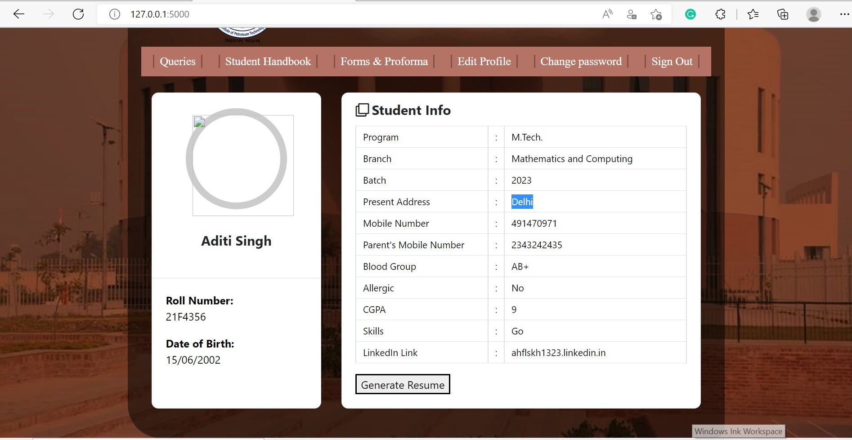

Slide 27
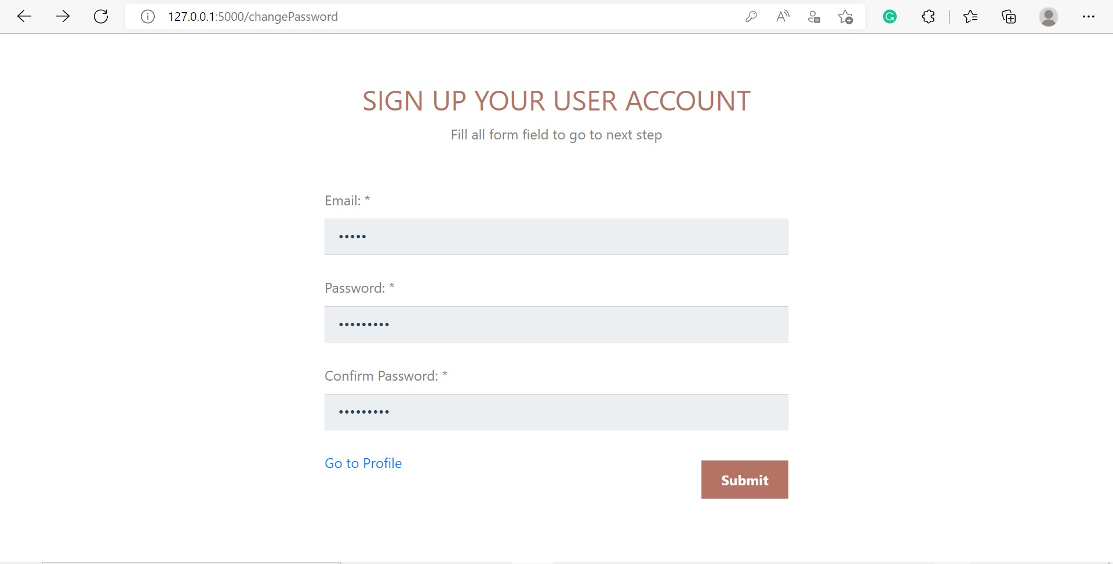

Slide 28
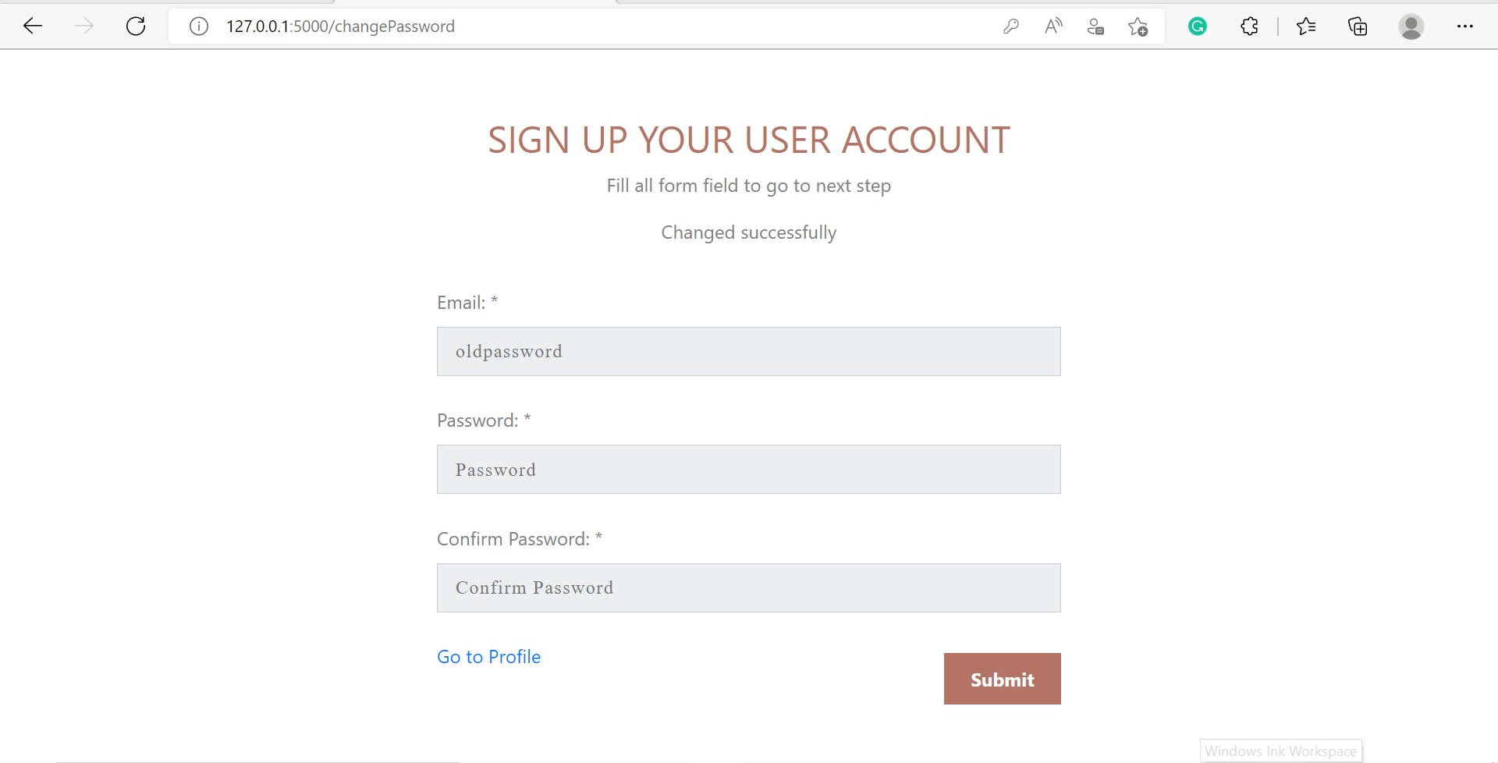

Slide 30
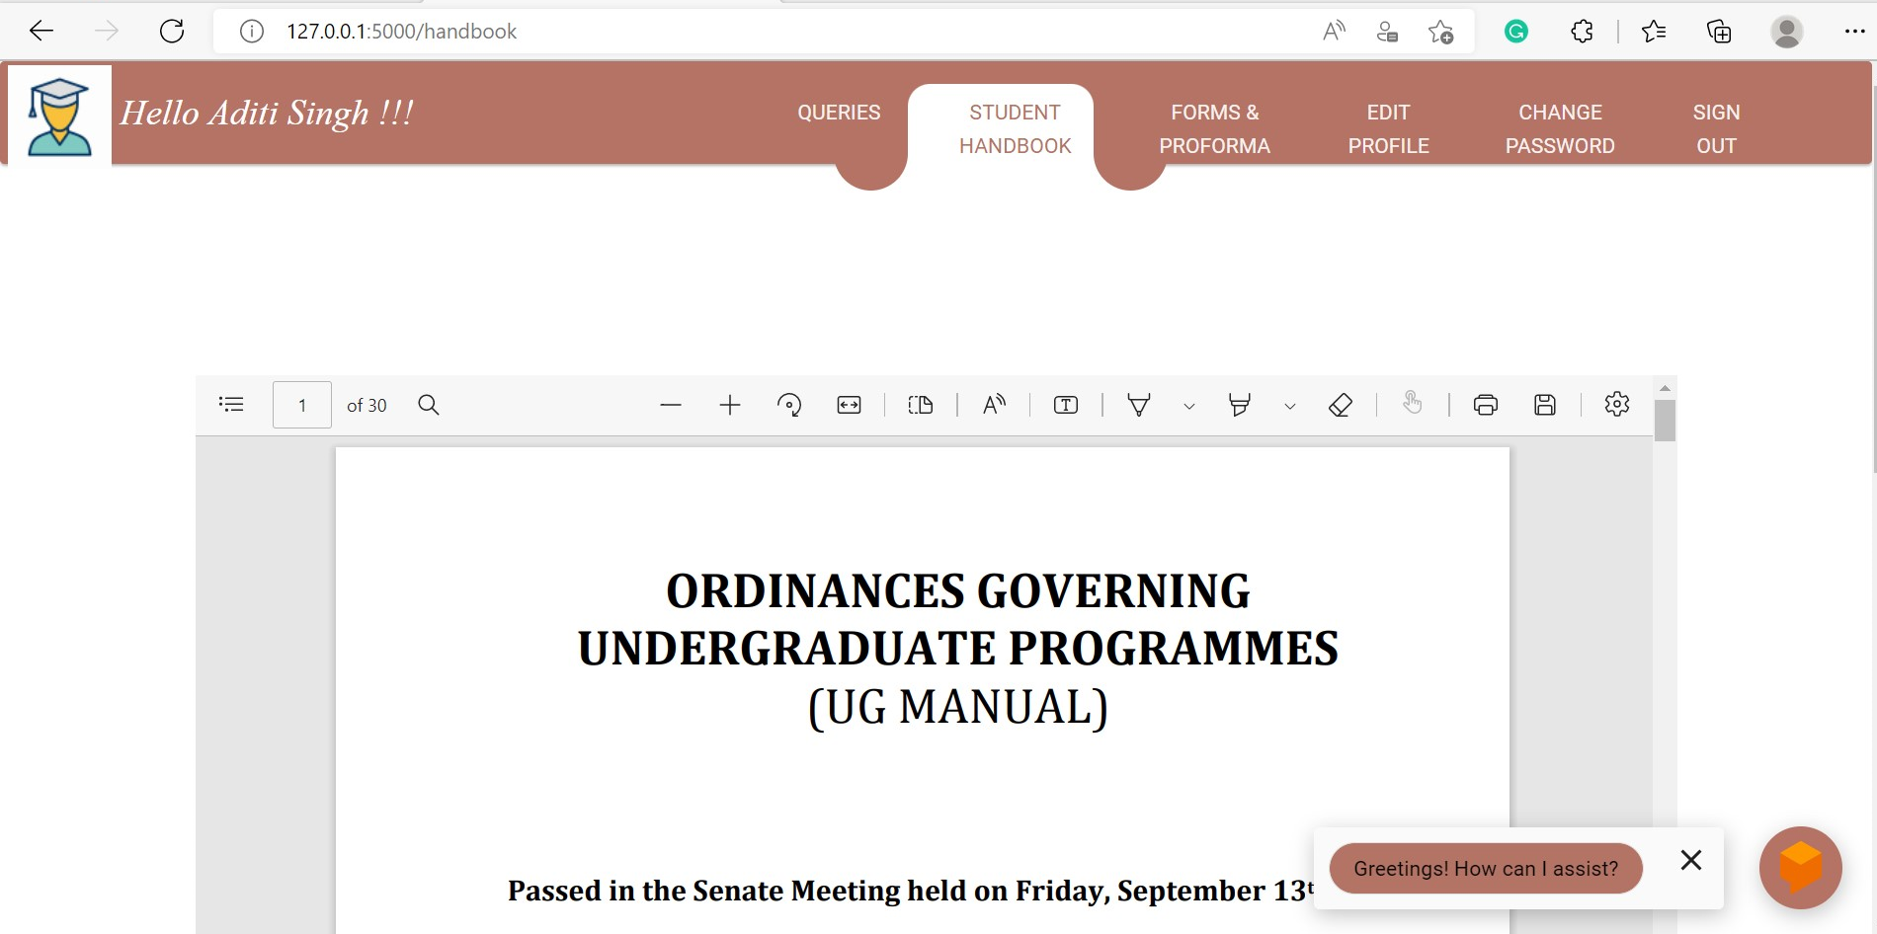

Slide 31
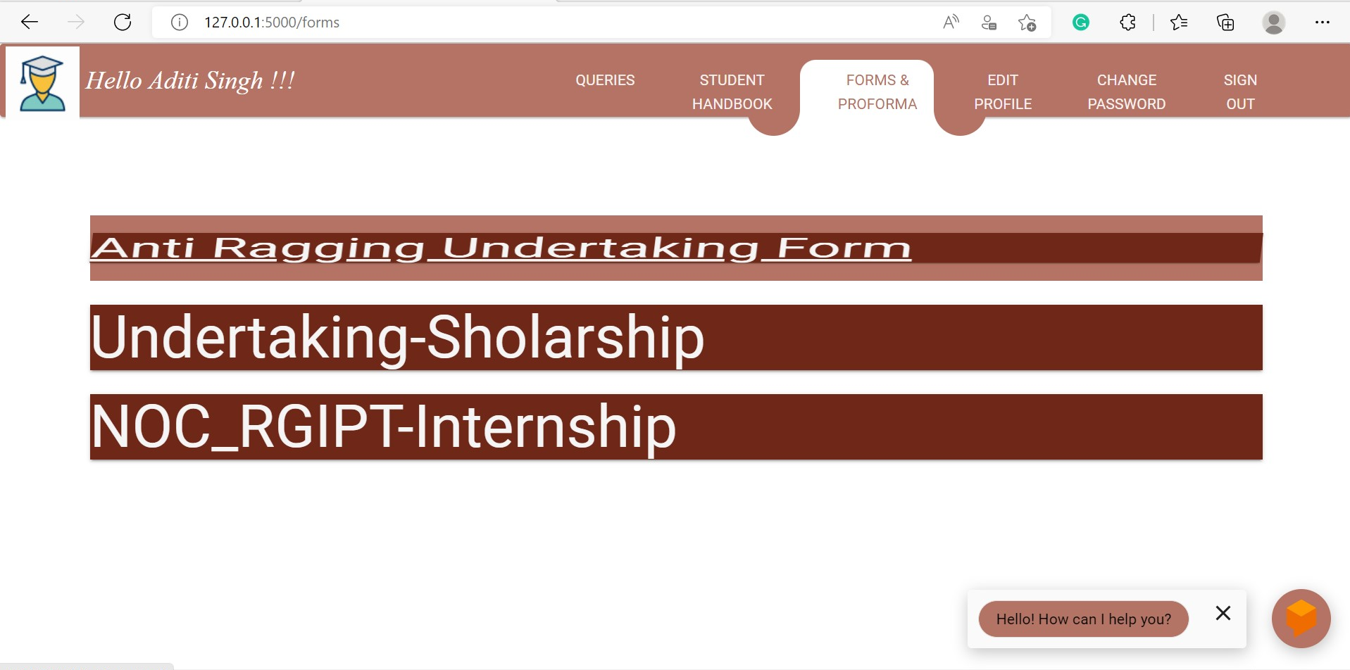

Slide 32
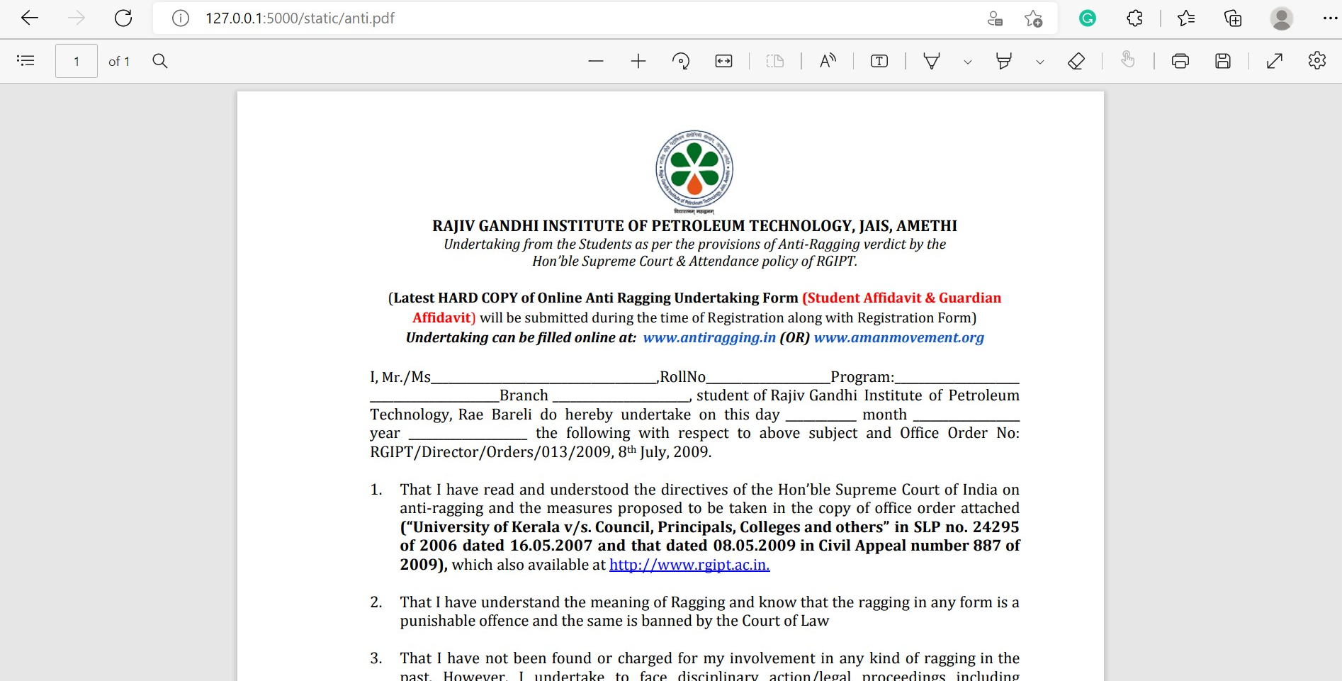

Slide 33
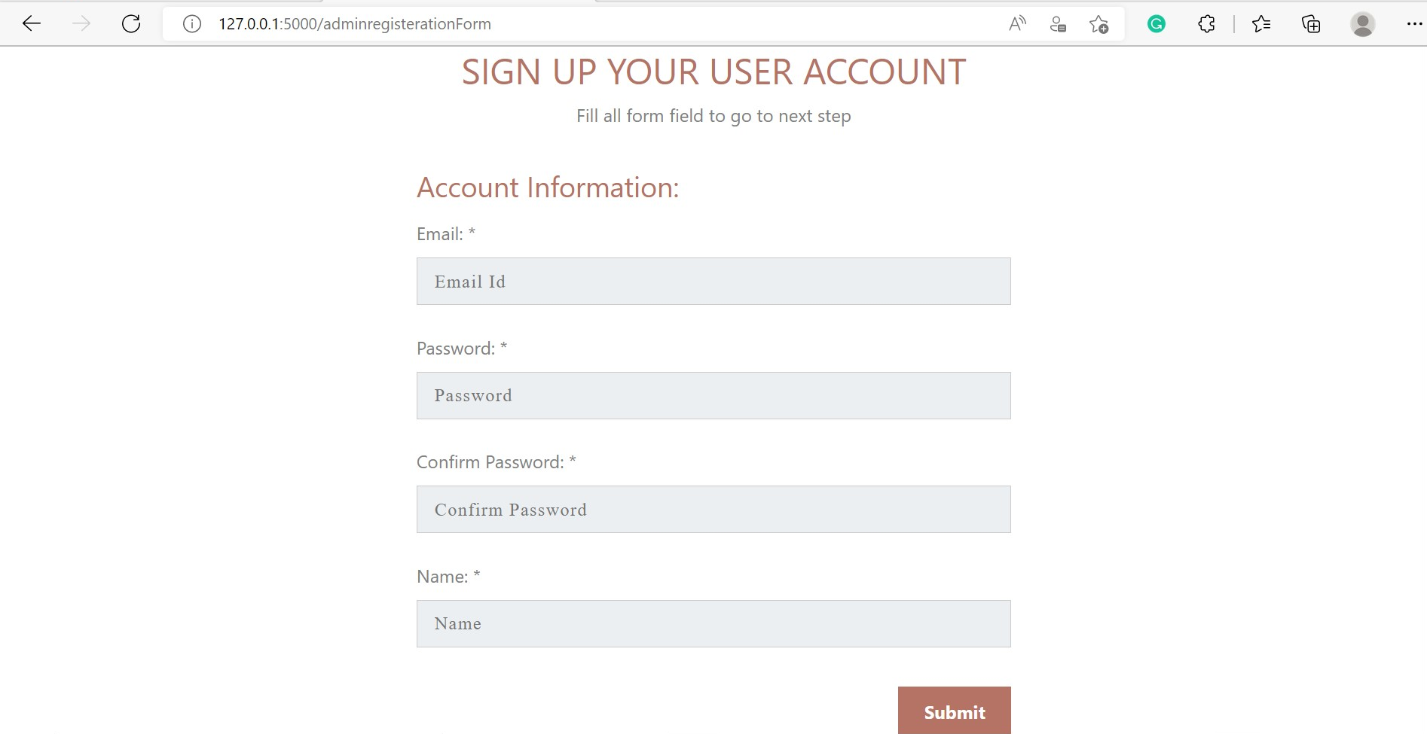

Slide 34
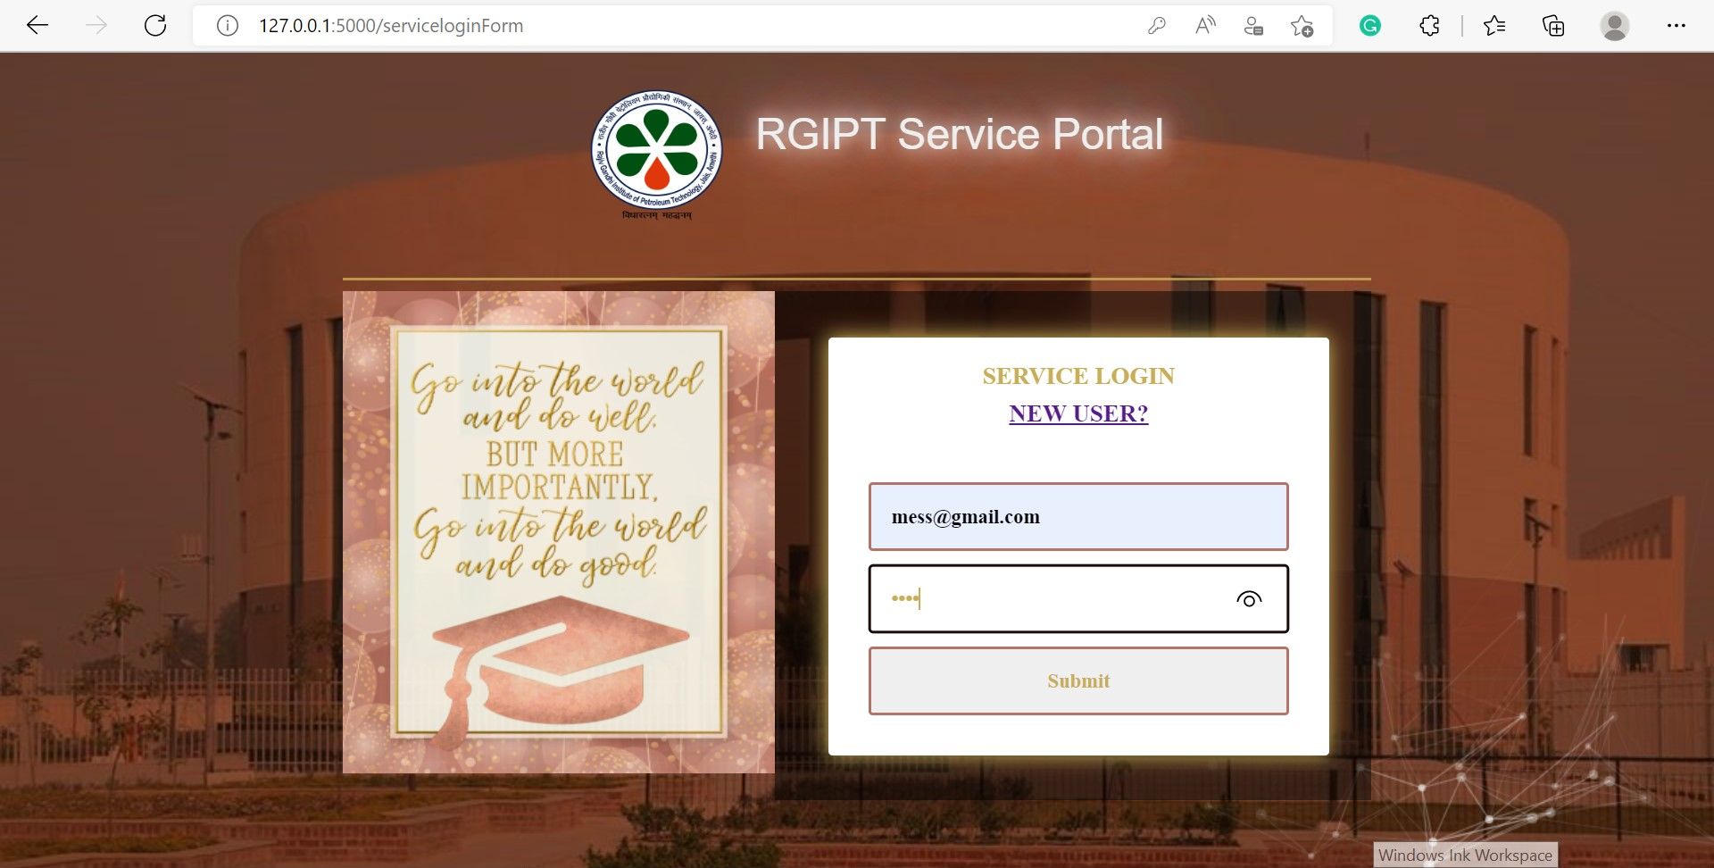

Slide 35
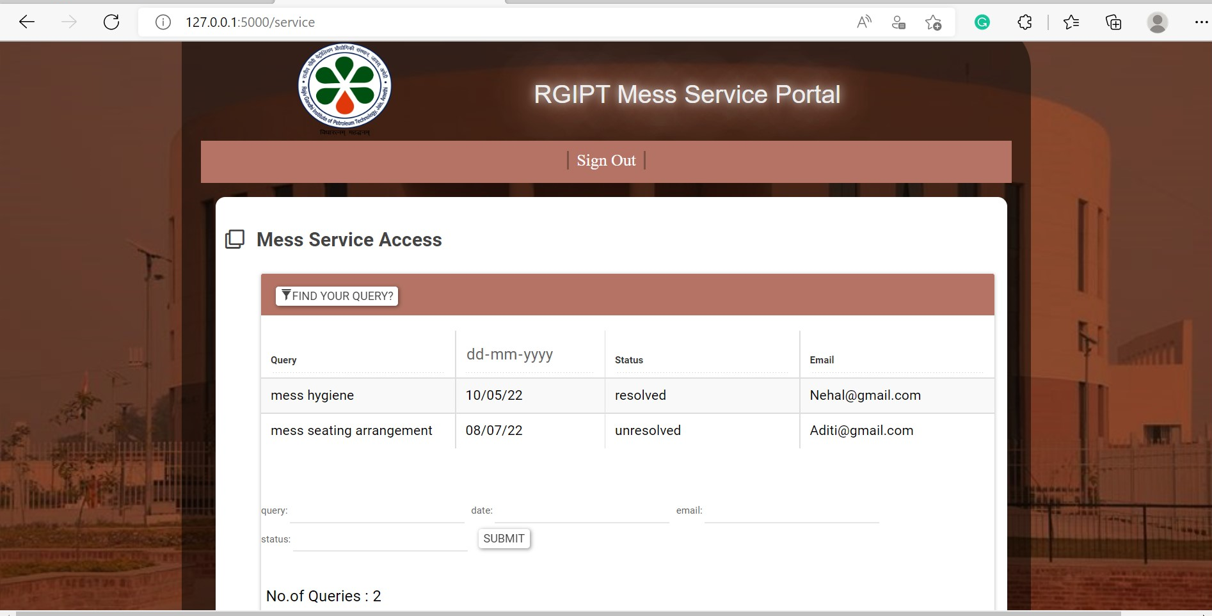

Slide 36
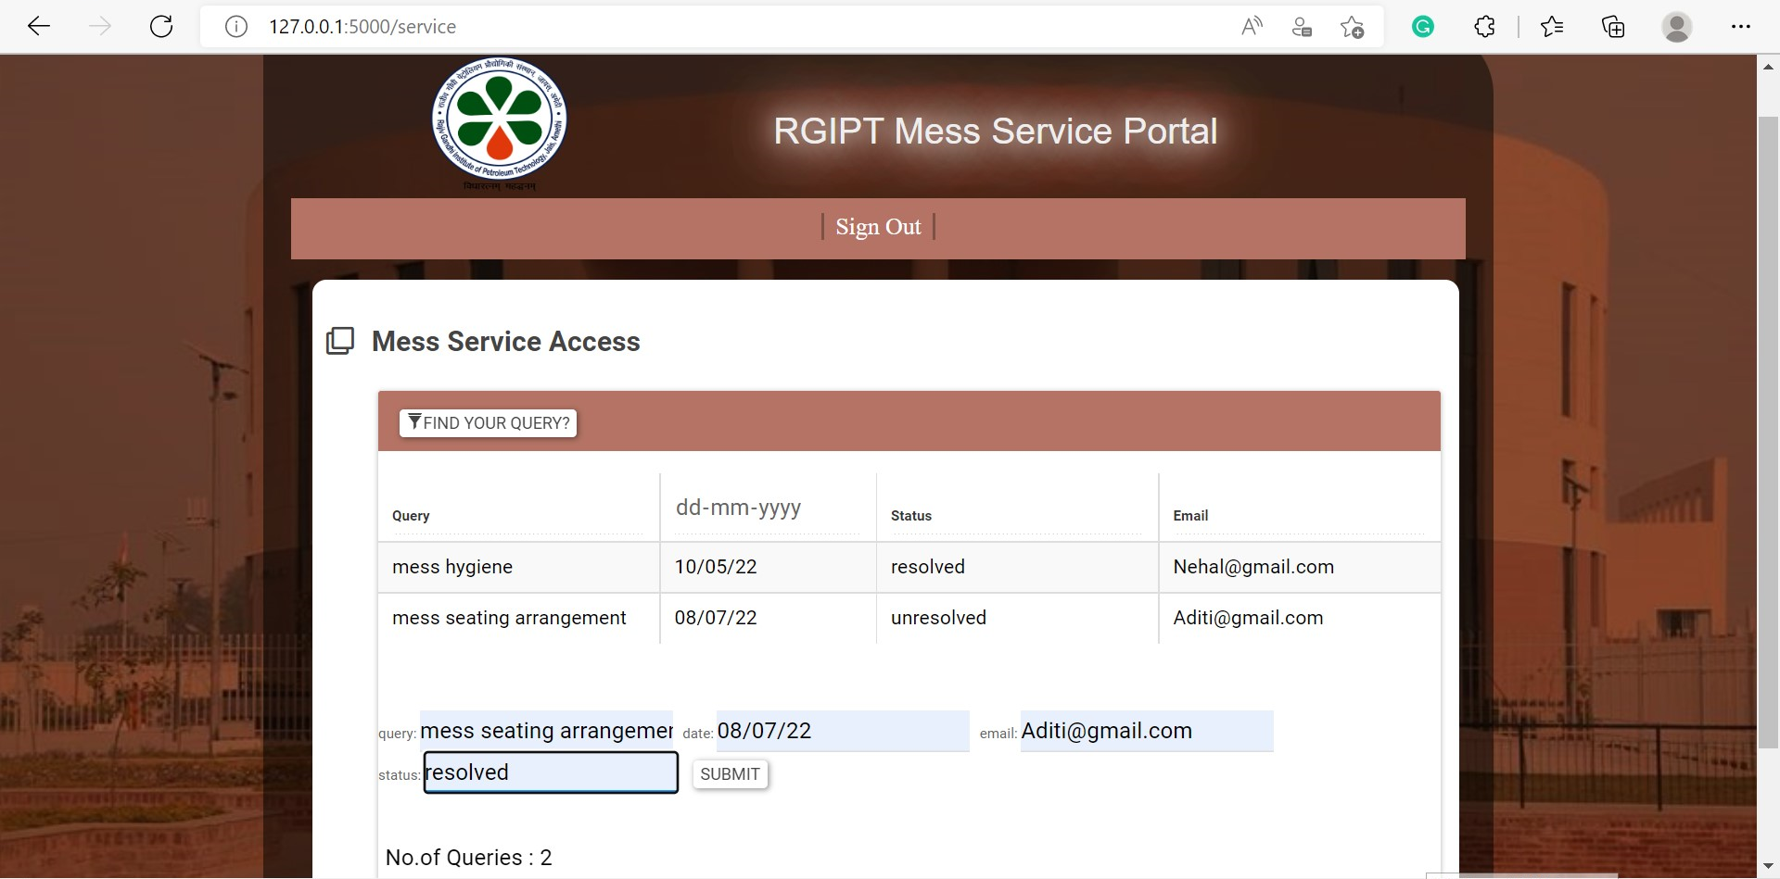

Slide 37
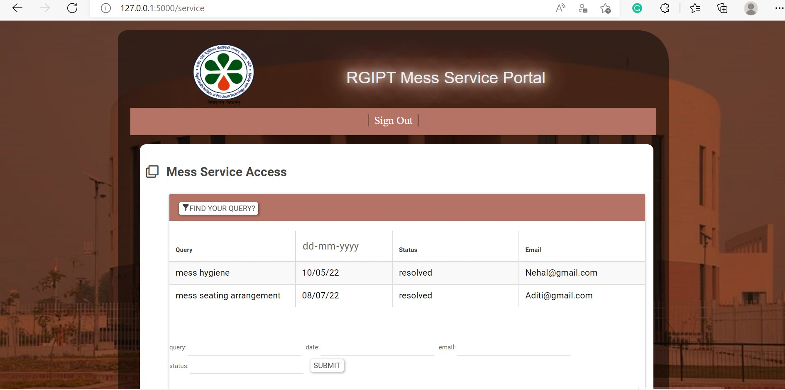

Slide 38
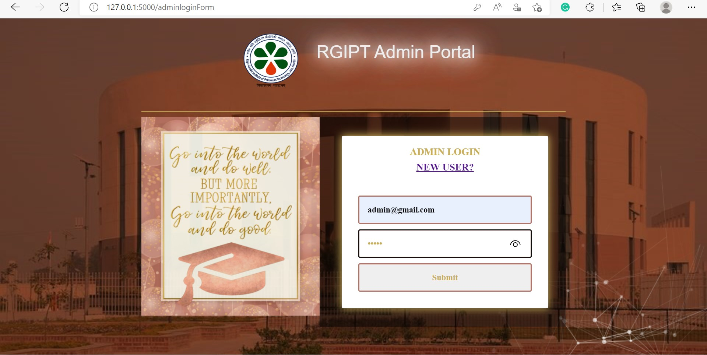

Slide 39
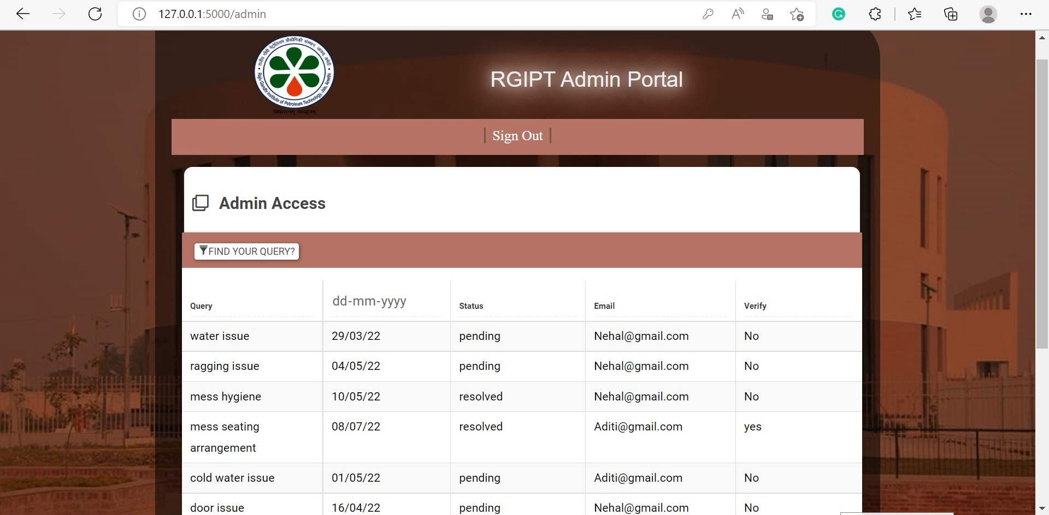

Slide 40
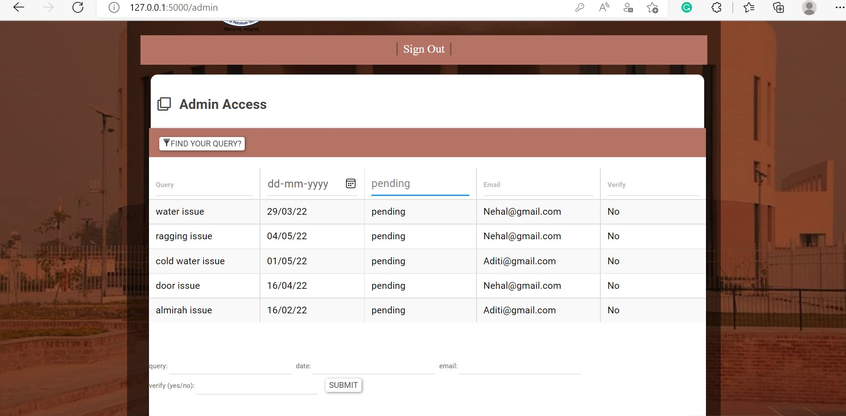

Slide 41
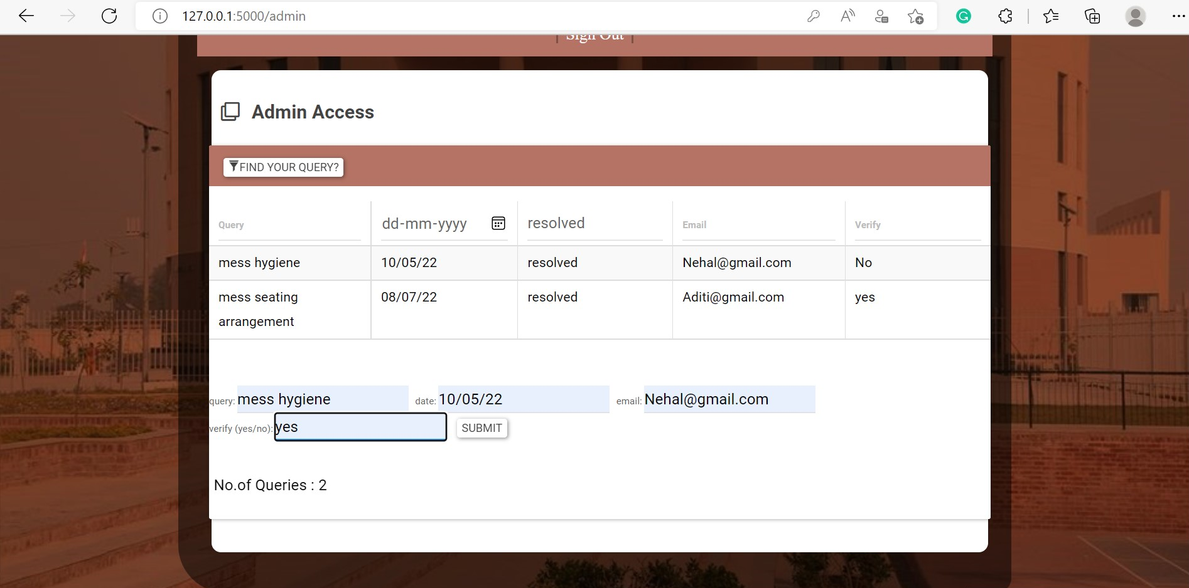

Slide 42
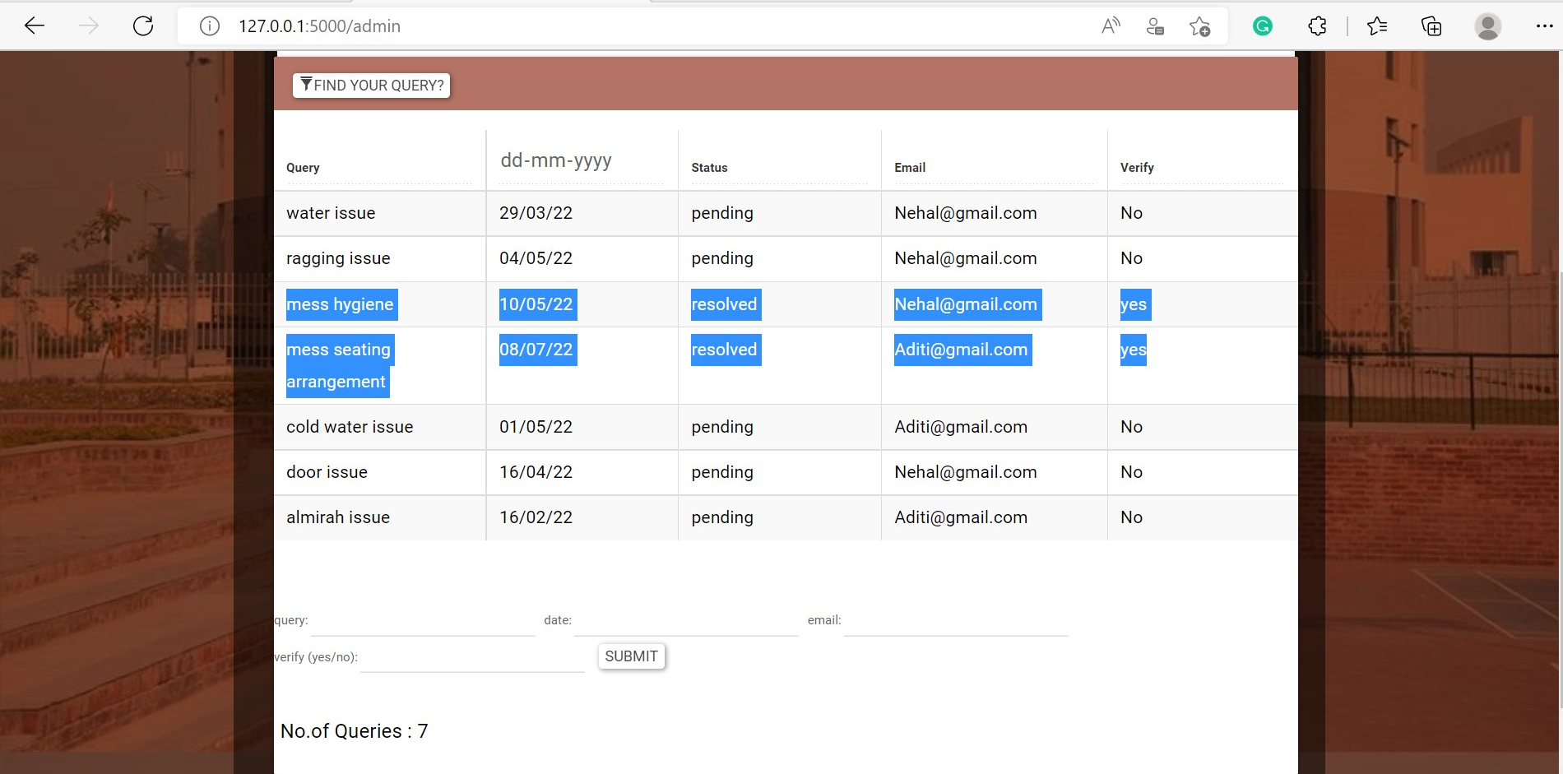

Slide 43
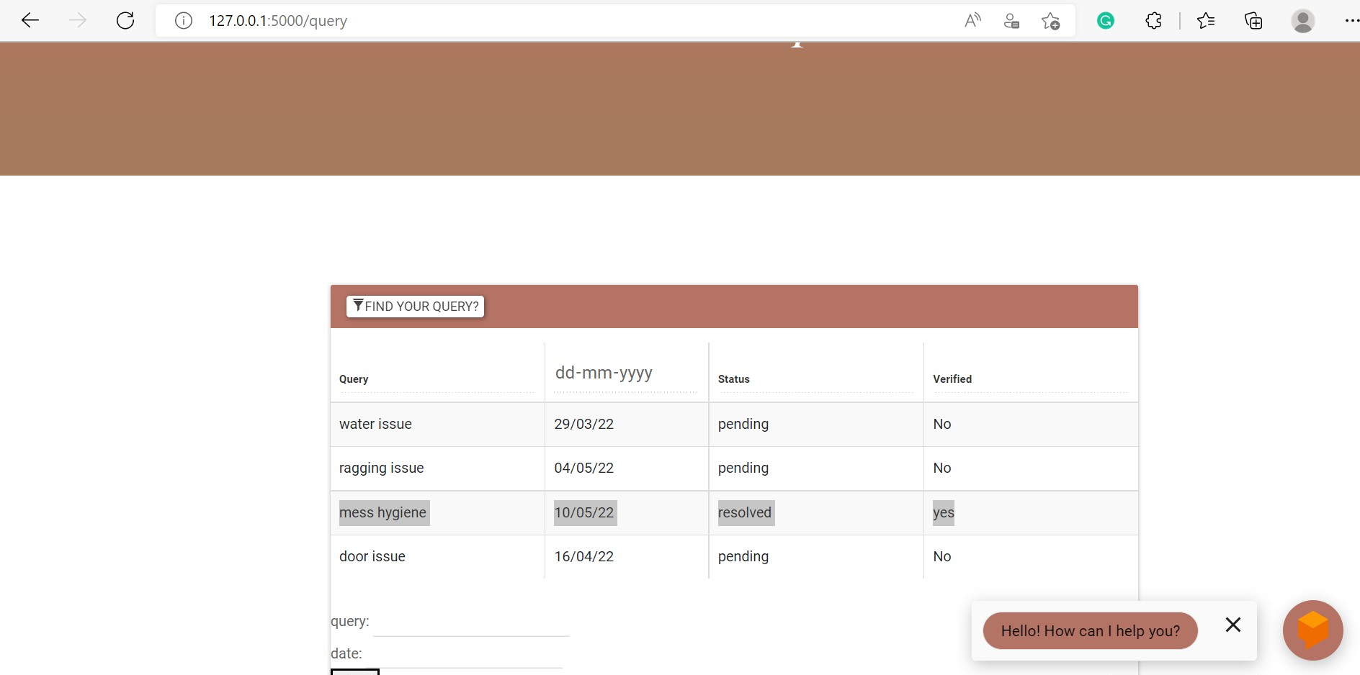

Slide 44
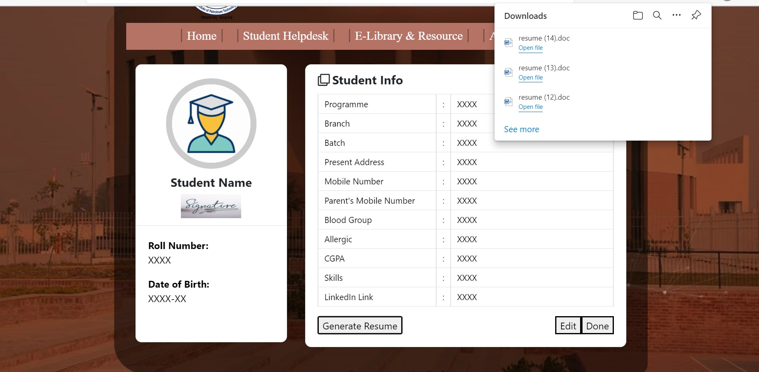

Slide 45
Thank you (Divyanshi Singh 20cs3028)

